Slide 1
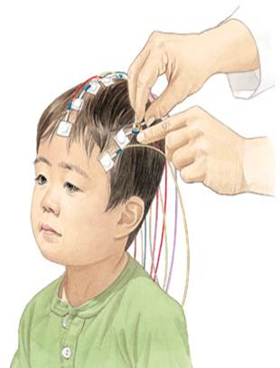
Final Presentation Estimating Brain Activation Patterns from EEG Data
Student: Gal Maman
Supervisor: Or Yair
Semester: Winter, 2017
Date: 08/05/2018
In Collaboration with: Dr. Danny Eitan

Slide 2
Outline
Medical Background
Project Goals
Overview project process
Results
Conclusions and Future Work

Slide 3
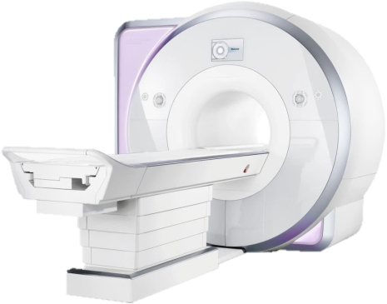
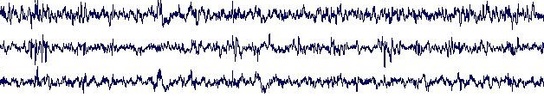
Medical Background
Acute brain injury is a common cause of death among children.
Problem:
Popular modalities for brain imaging are not always feasible or available at early stages of the illness.
Goal:
A system that:
Can be applied at the bedside of critically-ill patients.
Detect neurological injury.
Aid in guiding therapy and improve outcomes.
Solution:
Research brain activity using Electroencephalography (EEG) monitoring.

Slide 4
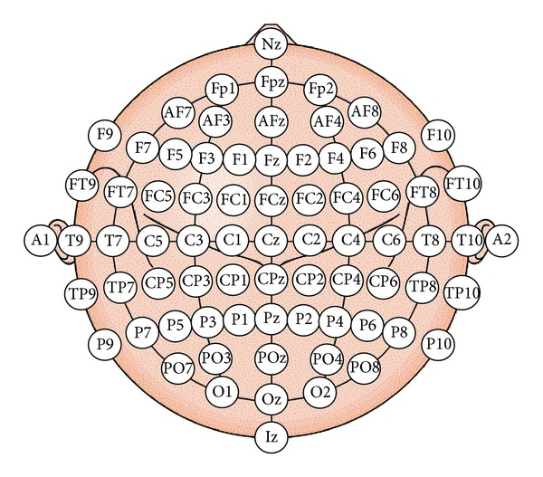
Objectives
Single shot EEG classification
Detect functional areas
Spatial sub-sampling

Slide 5
Our Raw Data
11 healthy volunteers ranged in age from 7 to 16 years.
5 critically-ill patients ranged in age from 2.5 to 16 years; all with various brain injuries.
Number of subjects
Age range

Slide 6
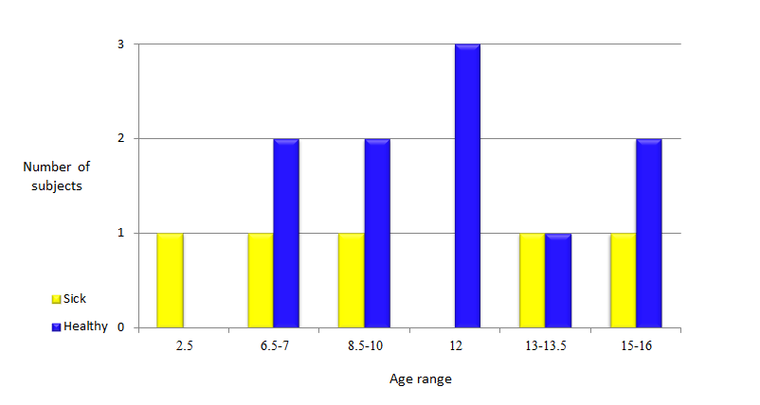
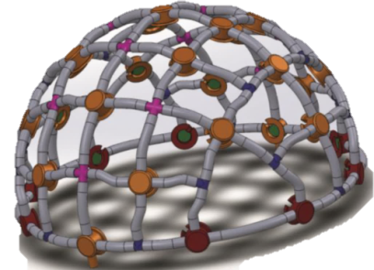
Our Raw Data
The stretchable electrode cap contained 64 EEG electrodes.

Slide 7
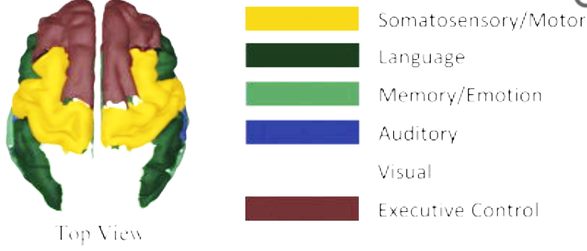
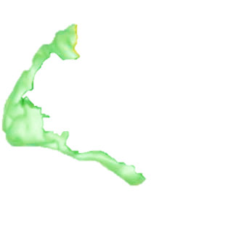
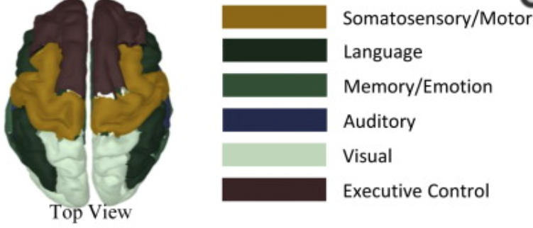
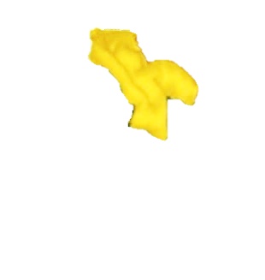
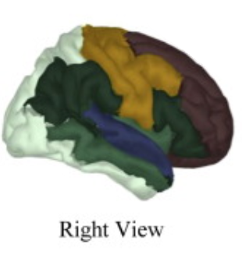
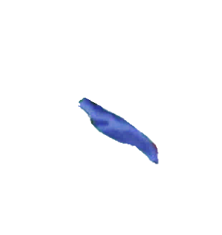
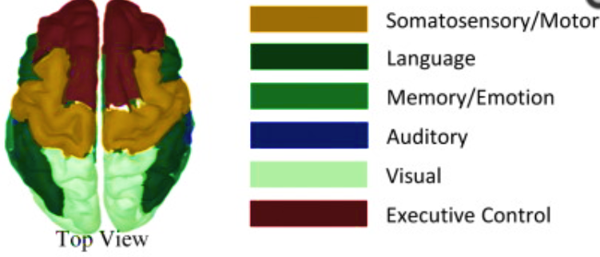
Our Raw Data
The set-up consists of three multi-modal sensory stimulation generators: somatosensory, auditory and visual.
2
6
1
The final data includes 200-1000 trials for each stimulus (9 stimulations) from every subject (16 subjects).

Slide 8
Overview Scheme Process System Diagram
Raw Data
Preprocessing
Statistical Features Extraction
Features Processing
Classification
Classified Data

Slide 9
Overview Scheme Process System Diagram
Raw Data
Preprocessing
Statistical Features Extraction
Features Processing
Classification
Classified Data
BP filter.
Down sampling.
Disqualify trials and electrodes.
➔ 32 electrodes

Slide 10
Overview Scheme Process System Diagram
Raw Data
Preprocessing
Statistical Features Extraction
Features Processing
Classification
Classified Data

Slide 11
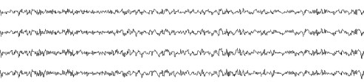
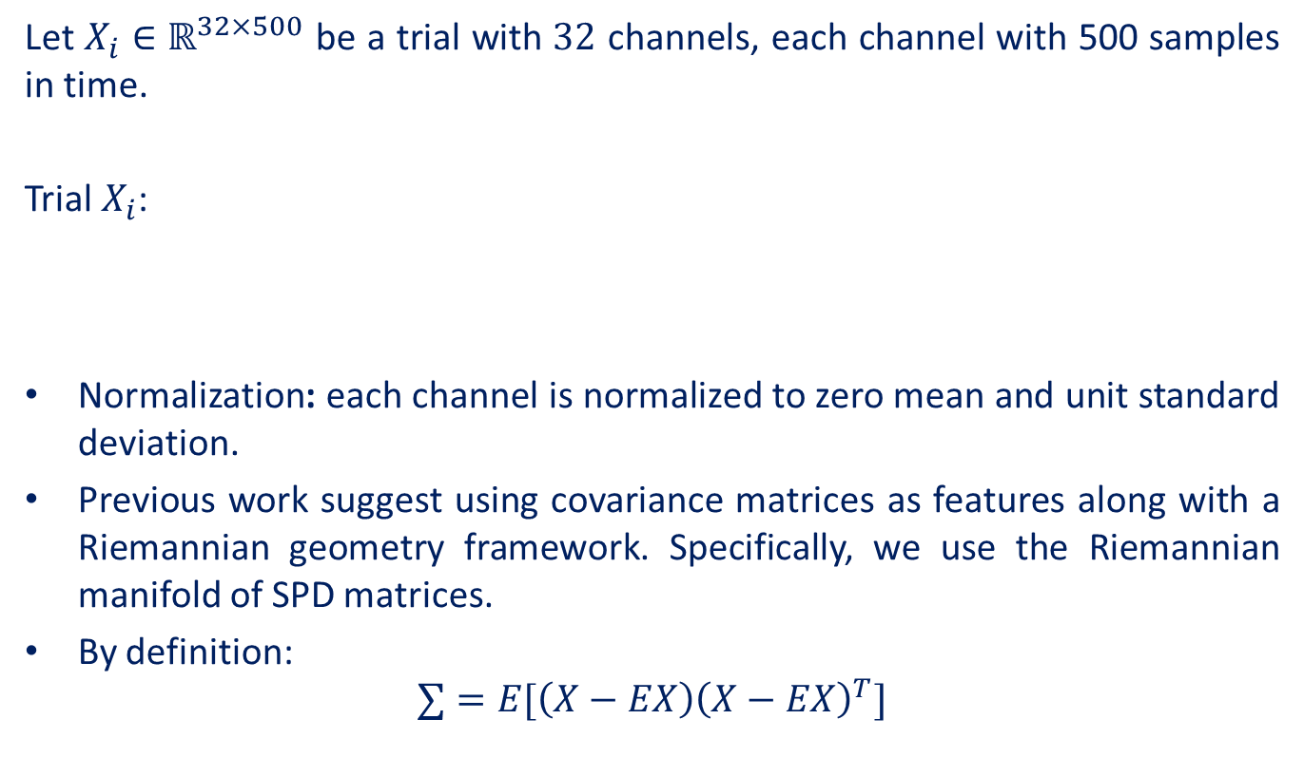



Statistical Features Extraction
Let $X_{i}∈ℝ^{32×500}$ be a trial with $32$ channels, each channel with 500 samples in time.
Trial $X_{i}$:
Normalization: each channel is normalized to zero mean and unit standard deviation.
Previous work suggest using covariance matrices as features along with a Riemannian geometry framework. Specifically, we use the Riemannian manifold of SPD matrices.
By definition:
$$∑=E[\left(X−EX\right){\left(X−EX\right)}^{T}]$$
$$500$$
$$32$$

Slide 12
Overview Scheme Process System Diagram
Raw Data
Preprocessing
Statistical Features Extraction
Features Processing
Classification
Classified Data

Slide 13

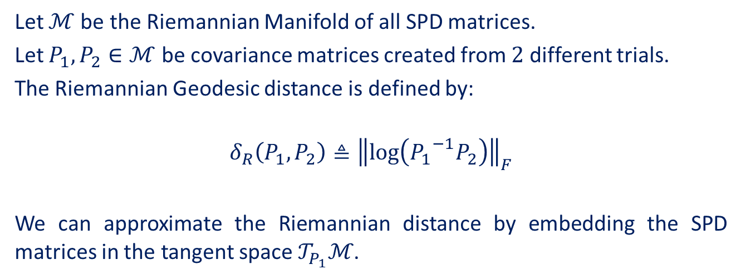
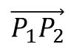
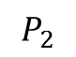
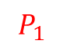

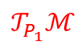
Riemannian Geometry
Let $ℳ$be the Riemannian Manifold of all SPD matrices.
Let $P_{1},P_{2}∈ℳ$ be covariance matrices created from $2$ different trials.
The Riemannian Geodesic distance is defined by:
$$δ_{R}\left(P_{1},P_{2}\right)≜{\left\|\log\left({P_{1}}^{−1}P_{2}\right)\right\|}_{F}$$
We can approximate the Riemannian distance by embedding the SPD matrices in the tangent space $𝒯_{P_{1}}ℳ$.
$$𝒯_{P_{1}}ℳ$$
$$\vec{P_{1}P_{2}}$$
$$P_{1}$$
$$\vec{P_{1}P_{2}}={Log}_{P_{1}}P_{2}{≜P_{1}}^{\frac{1}{2}}\log\left({P_{1}}^{−\frac{1}{2}}P_{2}{P_{1}}^{−\frac{1}{2}}\right){P_{1}}^{\frac{1}{2}}$$
$$P_{2}$$
$$ℳ$$

Slide 14

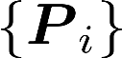
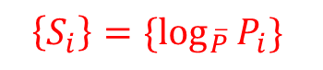

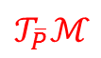
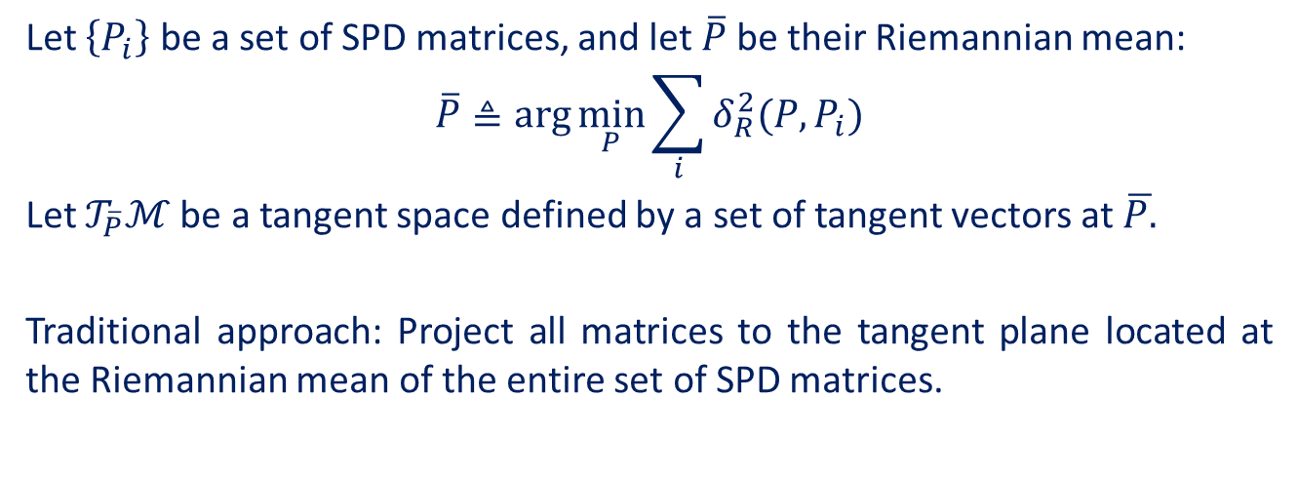
Let $\left\{P_{i}\right\}$ be a set of SPD matrices, and let $\overline{P}$be their Riemannian mean:
$$\overline{P}≜arg\min_{P}{\sum_{i}{δ_{R}^{2}(P,P_{i})}}$$
Let $𝒯_{\overline{P}}ℳ$be a tangent space defined by a set of tangent vectors at $\overline{P.}$
Traditional approach: Project all matrices to the tangent plane located at the Riemannian mean of the entire set of SPD matrices.
$$\left\{S_{i}\right\}=\{\log_{\overline{P}}{P_{i}\} }$$
$$𝒯_{\overline{P}}ℳ$$
$${\left\|S_{i}−S_{j}\right\|}_{F}\tilde{=} δ_{R}(P_{i},{ P}_{j})$$
$$ℳ$$

Slide 15
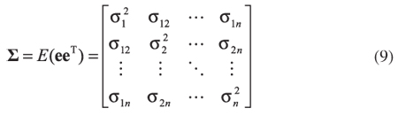
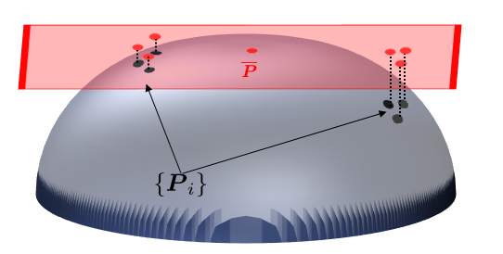

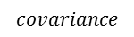


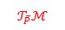

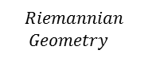
Example: 3 healthy subjects, 3 stimulations
$$Riemannian \\ Geometry$$
$$𝒯_{\overline{P}}ℳ$$
$$covariance$$
$$ℳ$$

Slide 16
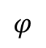
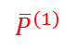
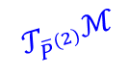
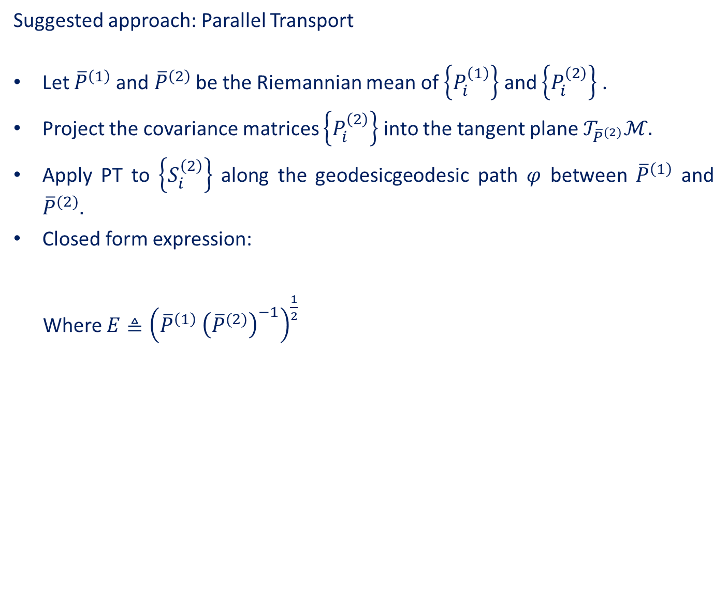
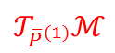


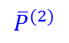

Suggested approach: Parallel Transport
Let ${\overline{P}}^{\left(1\right)}$and ${\overline{P}}^{\left(2\right)}$ be the Riemannian mean of $\left\{P_{i}^{\left(1\right)}\right\}$ and $\left\{P_{i}^{\left(2\right)}\right\}$ .
Project the covariance matrices $\left\{P_{i}^{\left(2\right)}\right\}$ into the tangent plane $𝒯_{{\overline{P}}^{(2)}}ℳ.$
Apply PT to $\left\{S_{i}^{\left(2\right)}\right\}$ along the geodesicgeodesic path $φ$ between ${\overline{P}}^{\left(1\right)}$ and ${\overline{P}}^{(2)}.$
Closed form expression:
Where $E≜{\left({\overline{P}}^{\left(1\right)} {\left({\overline{P}}^{(2)}\right)}^{−1}\right)}^{\frac{1}{2}}$
$$Ѱ_{P^{\left(2\right)},{ P}^{(1)}} \left(S_{i}^{\left(2\right)}\right)=E S_{i}^{(2)}E^{T}$$
$$\left\{S_{i}^{(2)}\right\}$$
$$φ$$
$${\overline{P}}^{(2)}$$
$$𝒯_{{\overline{P}}^{(2)}}ℳ$$
$${\overline{P}}^{\left(1\right)}$$
$$𝒯_{{\overline{P}}^{(1)}}ℳ$$
$$ℳ$$

Slide 17
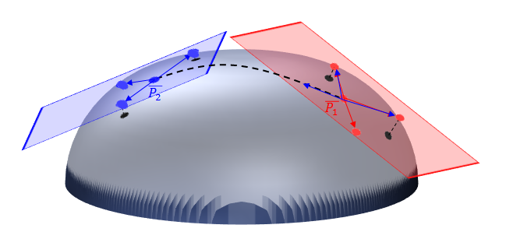

Example: 3 healthy subjects, 3 stimulations
$$ℳ$$

Slide 18
Without PT With PT

Slide 19
Rotation Using PCA
We have noticed that even though PT locates all the subjects around the same center, they remain with their original angle, which creates “X” shape:

Slide 20
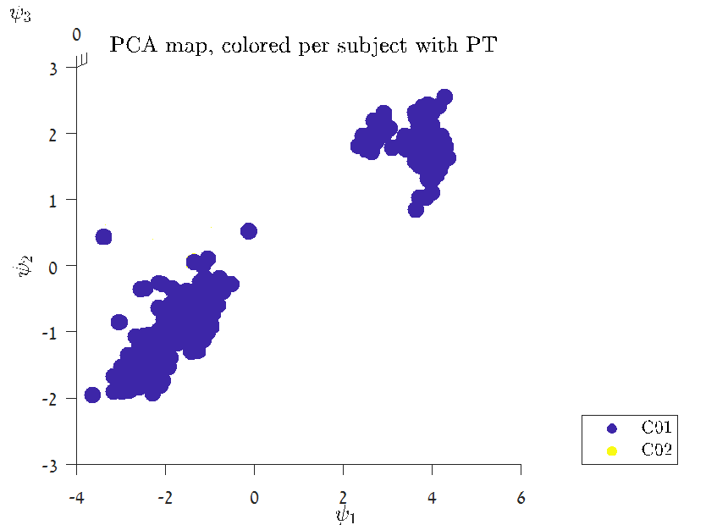
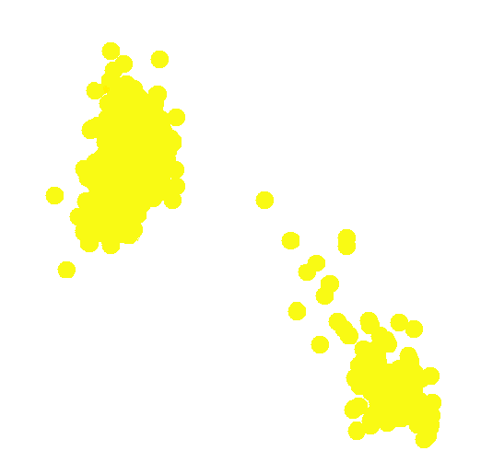
Rotation Using PCA
We have noticed that even though PT locates all the subjects around the same center, they remain with their original angle, which creates “X” shape:

Slide 21
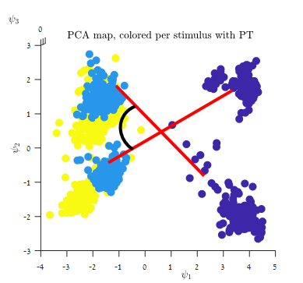
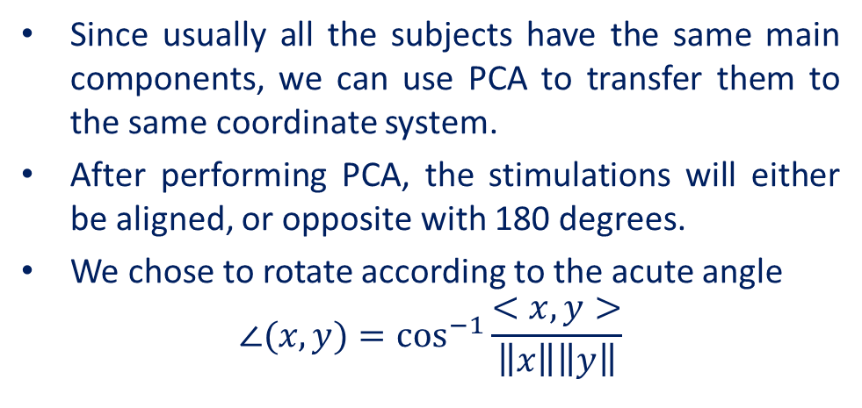
Rotation Using PCA
Since usually all the subjects have the same main components, we can use PCA to transfer them to the same coordinate system.
After performing PCA, the stimulations will either be aligned, or opposite with 180 degrees.
We chose to rotate according to the acute angle
$$∠(x,y)=\cos^{−1}{\frac{<x,y>}{\left\|x\right\|\left\|y\right\|}}$$

Slide 22
Without rotation With rotation

Slide 23
Without rotation With rotation

Slide 24
Overview Scheme Process System Diagram
Raw Data
Preprocessing
Statistical Features Extraction
Features Processing
Classification
Classified Data

Slide 25
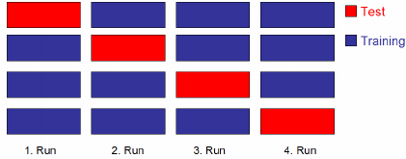
Classification Methods
We used different algorithms such as SVM, Trees etc.
We classified using “leave one out” method, i.e. we trained the classifier with all the subjects besides one, and tested the classifier on that subject.

Slide 26
Overview Scheme Process System Diagram
Raw Data
Preprocessing
Statistical Features Extraction
Features Processing
Classification
Classified Data

Slide 27
Single Shot EEG classification Results 3 Healthy subjects Stimulus 1,3,14

Slide 28
Single Shot EEG classification Results 8 Healthy subjects Stimulus 1,3,11

Slide 29
Linear SVM Classifier

Slide 30
Without rotation With rotation

Slide 31
Without rotation With rotation

Slide 32
Linear SVM Classifier

Slide 33
5 Sick Subjects Stimulus 1,3,14

Slide 34
Healthy Subjects vs Sick Subjects 2 Healthy subjects, 1 sick subject Stimulus 2,3,11

Slide 35
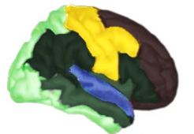
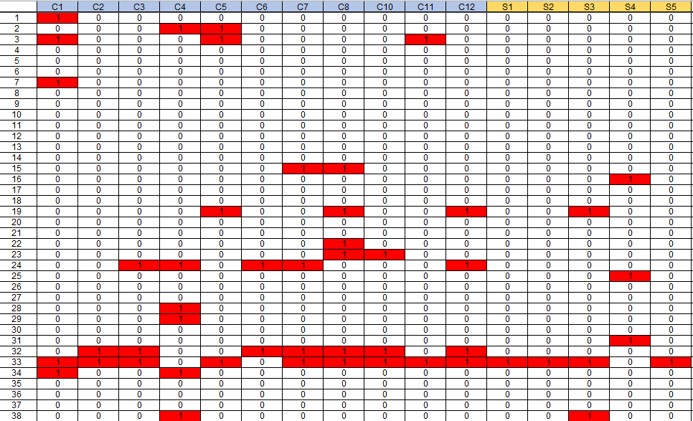
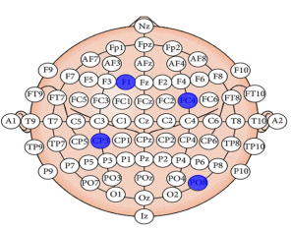
Spatial Sub-Sampling
Choose stimulations
Choose initial electrodes
Pick a set of subjects
Sub-sample

Slide 36
Spatial Sub-Sampling Results

Slide 37
Spatial Sub-Sampling Results

Slide 38
Spatial Sub-Sampling Results

Slide 39
Conclusion
We managed to reach good classification performance using PT and rotation, especially with stimulations from different functional areas.
We proved that the data can be sub-sampled (2-5 electrodes).

Slide 40
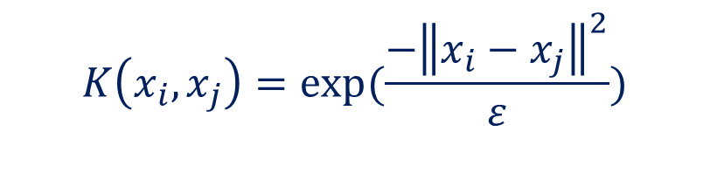
Future Work
Publish our conclusions so far.
Develop an algorithm that chooses the electrodes that best classify the data.
Use kernel matrix (SPD) instead of covariance, for example:
Deepen analysis in frequency domain
$$K\left(x_{i}, x_{j}\right)=exp(\frac{−{\left\|x_{i}−x_{j}\right\|}^{2}}{ε})$$

Slide 41
Time Domain Frequency Domain

Slide 42
Subject S02, 3 Stimulus
Time Domain Frequency Domain

Slide 43
References
TALMON, R; et al.‪ Diffusion Maps for Signal Processing: A Deeper Look at Manifold-Learning Techniques Based on Kernels and Graphs.‪ IEEE Signal Processing Magazine.‪ 30, 4, 75, July 2013.‪ ISSN: 10535888.‪‬‬‬‬‬‬‬‬‬‬‬‬‬‬‬‬‬‬‬‬‬‬‬‬‬‬‬‬‬‬
Alexandre Barachant ; et al. Multiclass Brain–Computer Interface Classification by Riemannian Geometry.‪ IEEE Transactions on Biomedical Engineering, Biomedical Engineering, IEEE Transactions on, IEEE Trans. Biomed. Eng.‪ USA, 4, 920, 2012.‪ ISSN: 1558-2531.‪‬‬‬‬‬‬‬‬‬‬‬‬‬‬‬‬‬‬‬‬‬‬‬‬

Slide 44


